Slide 1
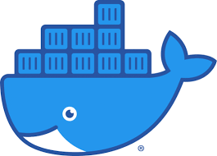

Slide 2
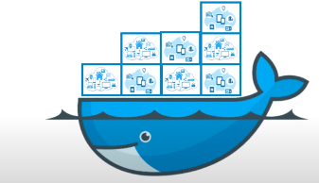
Docker
Docker is gaining popularity and its usage is spreading like wildfire. The reason for Docker’s growing popularity is the extent to which it can be used in an IT organization. Very few tools out there have the functionality to find itself useful to both developers and as well as system administrators. Docker is one such tool that truly lives up to its promise of Build, Ship and Run.
In simple words, Docker is a software containerization platform, meaning you can build your application, package them along with their dependencies into a container and then these containers can be easily shipped to run on other machines.

Slide 3
For example: Lets consider a linux based application which has been written both in Ruby and Python. This application requires a specific version of linux, Ruby and Python.
In order to avoid any version conflicts on user’s end, a linux docker container can be created with the required versions of Ruby and Python installed along with the application.
Now the end users can use the application easily by running this container without worrying about the dependencies or any version conflicts.
The same task can also be achieved using Virtual Machines, however it is not very efficient.

Slide 4
What is Virtualization?
Virtualization is the technique of importing a Guest operating system on top of a Host operating system.
This technique was a revelation at the beginning because it allowed developers to run multiple operating systems in different virtual machines all running on the same host.
This eliminated the need for extra hardware resource. The advantages of Virtual Machines or Virtualization are:
Multiple operating systems can run on the same machine
Maintenance and Recovery were easy in case of failure conditions
Total cost of ownership was also less due to the reduced need for infrastructure

Slide 5
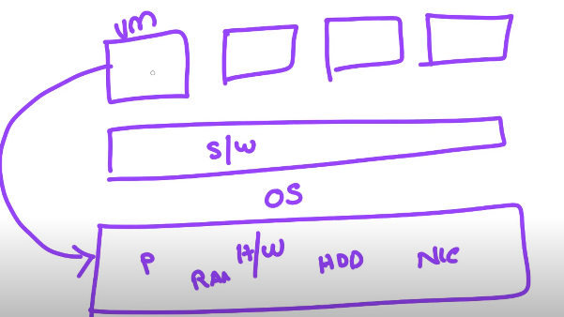
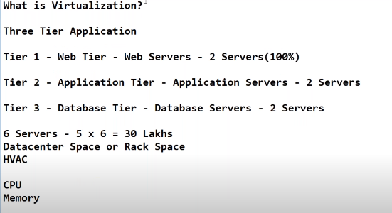
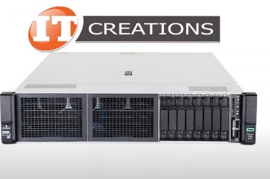

Slide 6
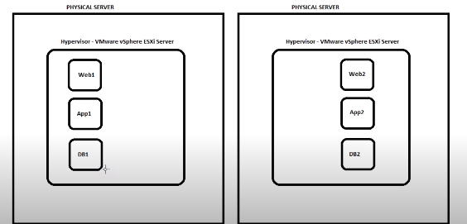
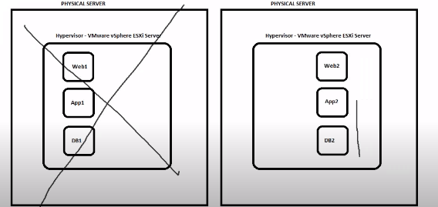
In case of any failure, the other server is ready

Slide 7
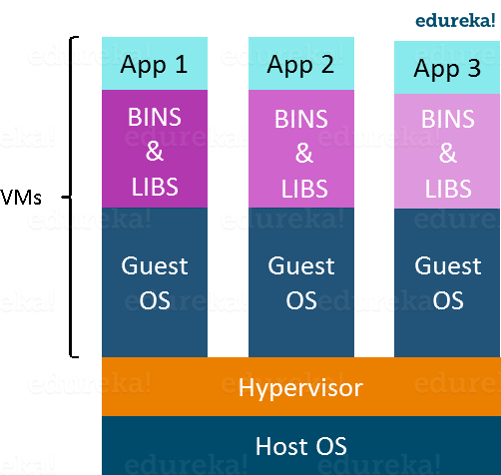
In the diagram on the right, you can see there is a host operating system on which there are 3 guest operating systems running which is nothing but the virtual machines.
As you know nothing is perfect, Virtualization also has some shortcomings. Running multiple Virtual Machines in the same host operating system leads to performance degradation.
Another problem with Virtual Machines which uses virtualization is that it takes almost a minute to boot-up. This is very critical in case of real-time applications.

Slide 8
Following are the disadvantages of Virtualization:
Running multiple Virtual Machines leads to unstable performance
Hypervisors are not as efficient as the host operating system
Boot up process is long and takes time
These drawbacks led to the emergence of a new technique called Containerization. Now let me tell you about Containerization.

Slide 9
What is Containerization?
Containerization is the technique of bringing virtualization to the operating system level.
Containerization brings abstraction to the operating system. Do note that Containerization is also a type of Virtualization.
Containerization is however more efficient because there is no guest OS here and utilizes a host’s operating system, share relevant libraries & resources as and when needed unlike virtual machines.
Application specific binaries and libraries of containers run on the host kernel, which makes processing and execution very fast. Even booting-up a container takes only a fraction of a second. Because all the containers share, host operating system and holds only the application related binaries & libraries. They are lightweight and faster than Virtual Machines.

Slide 10
Advantages of Containerization over Virtualization:
Containers on the same OS kernel are lighter and smaller
Better resource utilization compared to VMs
Boot-up process is short and takes few seconds

Slide 11
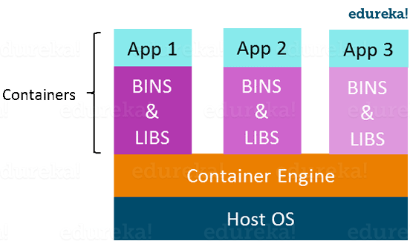

Slide 12
Virtualization vs Containerization
Virtualization and Containerization both let you run multiple operating systems inside a host machine.
Virtualization deals with creating many operating systems in a single host machine. Containerization on the other hand will create multiple containers for every type of application as required.
As we can see from the image, the major difference is that there are multiple Guest Operating Systems in Virtualization which are absent in Containerization. The best part of Containerization is that it is very lightweight as compared to the heavy virtualization.

Slide 13
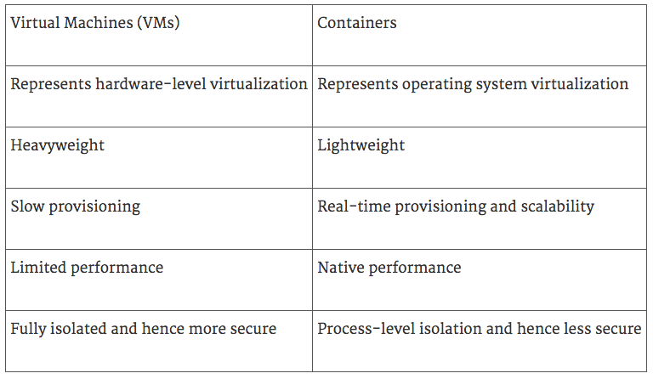
In the diagram on the right, you can see that there is a host operating system which is shared by all the containers. Containers only contain application specific libraries which are separate for each container and they are faster and do not waste any resources

Slide 14
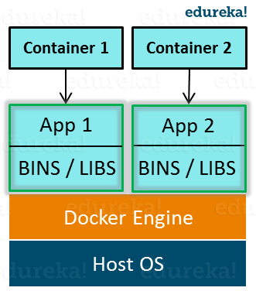
DOCKER
Docker is a containerization platform that packages your application and all its dependencies together in the form of Containers to ensure that your application works seamlessly in any environment.
As you can see in the diagram on the right, each application will run on a separate container and will have its own set of libraries and dependencies. This also ensures that there is process level isolation, meaning each application is independent of other applications, giving developers surety that they can build applications that will not interfere with one another.

Slide 15
As a developer, I can build a container which has different applications installed on it and give it to my QA team who will only need to run the container to replicate the developer environment.
Benefits of Docker
Now, the QA team need not install all the dependent software and applications to test the code and this helps them save lots of time and energy.
This also ensures that the working environment is consistent across all the individuals involved in the process, starting from development to deployment. The number of systems can be scaled up easily and the code can be deployed on them effortlessly.
Advantages
The main advantages of Docker are:
Resource Efficiency: Process level isolation and usage of the container host’s kernel is more efficient when compared to virtualizing an entire hardware server.
Portability: All the dependencies for an application are bundled in the container. This means they can be easily moved between development, test, and production environments.
Continuous Deployment and Testing: The ability to have consistent environments and flexibility with patching has made Docker a great choice for teams that want to move from waterfall to the modern DevOps approach to software delivery.

Slide 16
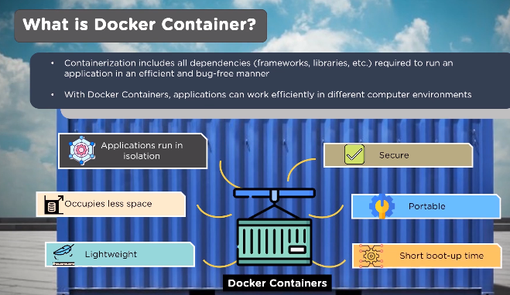

Slide 17
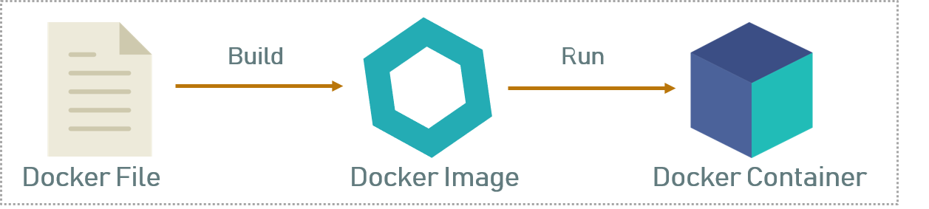
Docker file, Images & Containers
Docker file, Docker Images & Docker Containers are three important terms that you need to understand while using Docker.
As you can see in the above diagram when the Dockerfile is built, it becomes a Docker Image and when we run the Docker Image then it finally becomes a Docker Container.

Slide 18
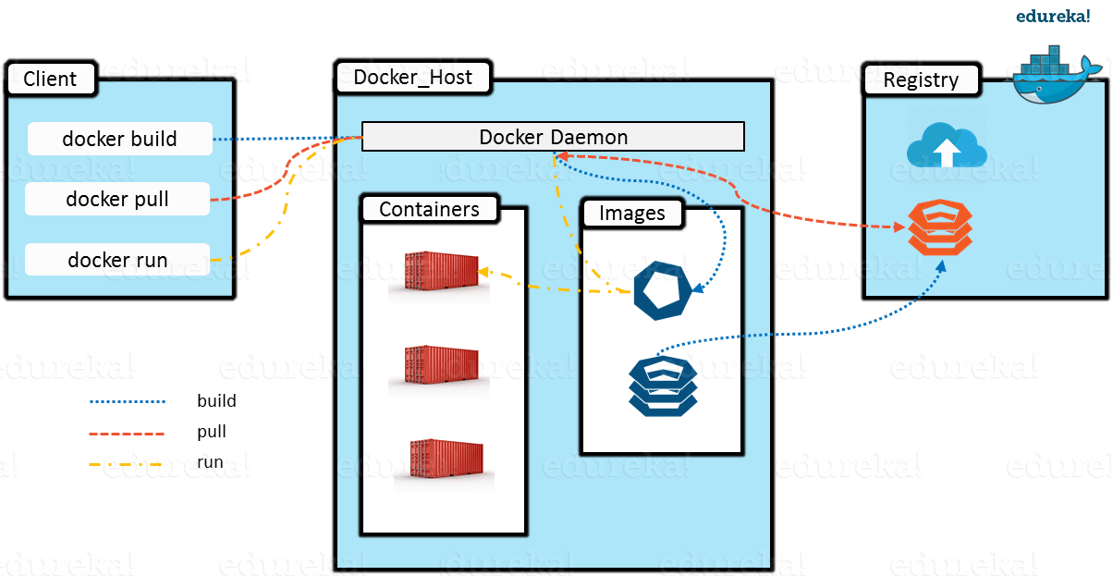
What is Docker Architecture?
Docker Architecture includes a Docker client – used to trigger Docker commands, a Docker Host – running the Docker Daemon and a Docker Registry – storing Docker Images. The Docker Daemon running within Docker Host is responsible for the images and containers.

Slide 19
To build a Docker Image, we can use the CLI (client) to issue a build command to the Docker Daemon (running on Docker Host). The Daemon will then build an image based on our inputs and save it in the Registry, which can be either Docker hub or a local repository
If we do not want to create an image, then we can just pull an image from the Docker hub, which would have been built by a different user
Finally, if we have to create a running instance of my Docker image, we can issue a run command from the CLI, which will create a Container.

